Slide 1
Design Patterns RESUME
User and Developer Manual

Slide 2
Console Project – application overview
The application is simply divided in 3 tab sections in which the main design patterns categories are presented.
For each category there are the list (buttons) of available design patterns

Slide 3
Console Project – fixed buttons
Exit and minimize buttons are always available in the context: you can minimize the application (which is set to full screen) or exit from it at anytime

Slide 4
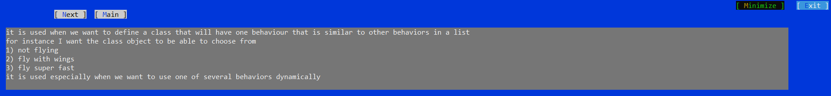
Console Project – page description
For each of the available pattern there are 2 types of pages. The first one in the description page, in which only a main description is shown.
The description page has the following view (blue screen and gray characters):

Slide 5
Console Project – example description
The second available page is a page of example. In this context a brief description of the example is given and a second view renders the class of the example at hand.
The example page has the following characteristics:

Slide 6
Console Project – wrong button
When the current example has a counterexample, it is often showed clicking on the wrong button.
Another instance of the application will start showed a console with the wrong class case:

Slide 7
Console Project – prev – next buttons
For moving forward and behind in the demo, the previous and next page buttons are rendered in the page (previous on left and next on right). Sometimes they change a bit when passing from a description to an example page and viceversa:

Slide 8
Console Project – Main button
For the presentation the main button is always available: with it, it is always possible to come back to the original context (the tabular page with all the alternatives available):

Slide 9
Console Project – demo button
When concluding the presentation part, it will be possible seeing the demo too. This is available on the last page of each of the presented patterns:

Slide 10
Console Project – demo
Demo is contained in another instance of the application: it could vary depending on the selected pattern.
Usually a DEMO is made such that it is stopped at each line or block of lines of relevant code, given precise information to the user concerning what is happening:

Slide 11
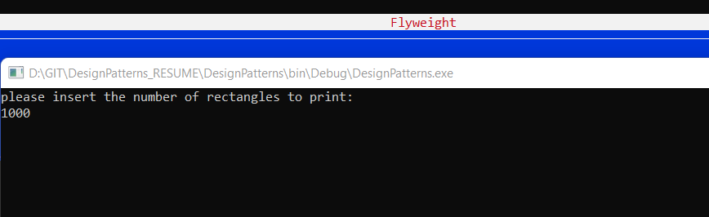
Console Project – demo
But sometimes it could be also represented by a different application with a different logic. In any case instructions are presented to the user:

Slide 12
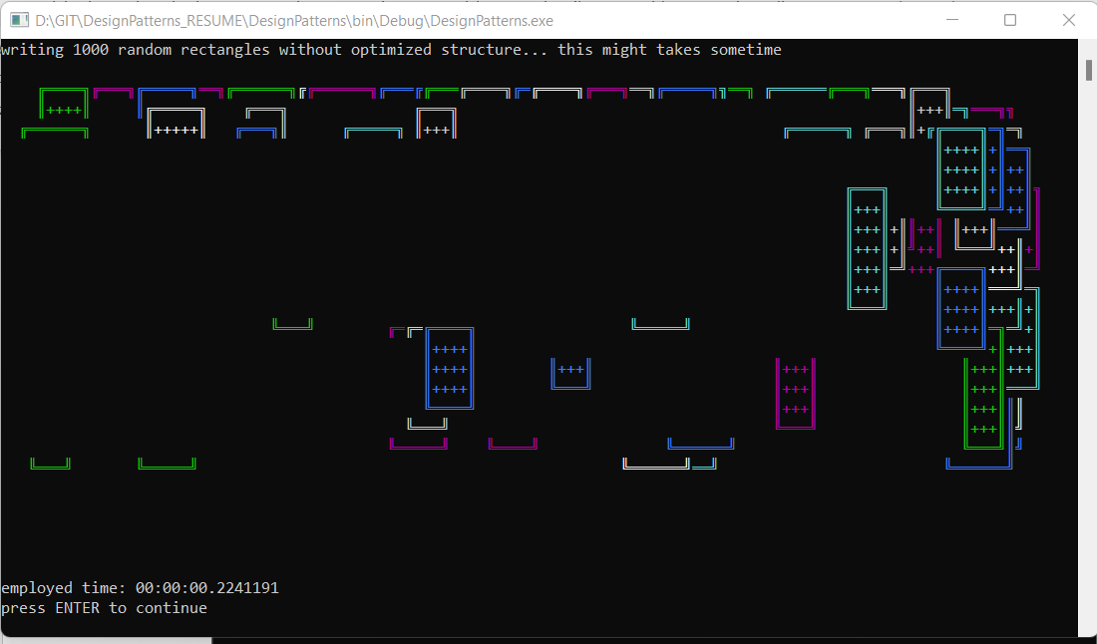
Console Project – demo
But sometimes it could be also represented by a different application with a different logic. In any case instructions are presented to the user:

Slide 13
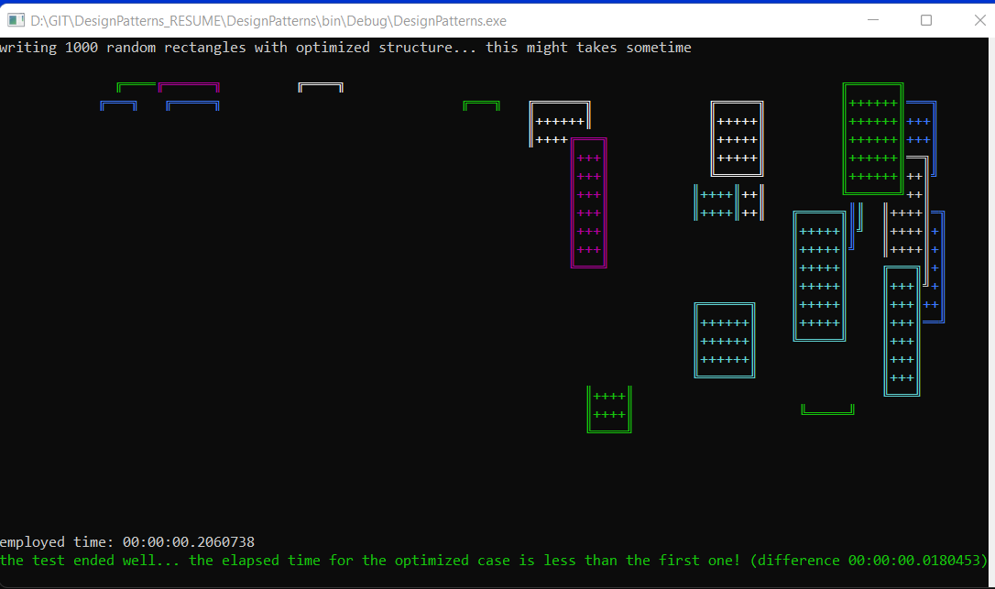
Console Project – demo
But sometimes it could be also represented by a different application with a different logic. In any case instructions are presented to the user:

